Slide 1
SWUFE-UD IDS Reimbursement Policy
Fall 2025

Slide 2
Airfare
UD will cover the cost of a round-trip economy plus ticket between the USA and Chengdu, priced at a maximum of $3,400 for each UD faculty.
Airfare coverage: For round-trip tickets between USA and Chengdu, you can choose to arrive at Shuangliu International Airport or Chengdu Tianfu International Airport. If you are planning to stop at a third country/location, please consult with Dora Tseng (dorat@udel.edu) in advance.

Slide 3
Airfare Reimbursement
How to reimburse:
Book your tickets with your UD or personal credit card.
Reimburse on Concur after your trip
Speedtype: BUEC212112
Trip Purpose: Local UD Business

Slide 4
Per Diem Housing Allowance
As a Lerner College faculty member, you are entitled to a housing allowance during your stay at SWUFE. The per diems are as follows:
Individual Faculty (1,000 RMB per week) or
Family with Faculty (1,250 RMB per week)
You will receive an MOU from Dora before your trip to China, and you can submit it to Concur once you return from China.
Some helpful tips for submitting your per diem housing allowance in Concur follow.

Slide 5
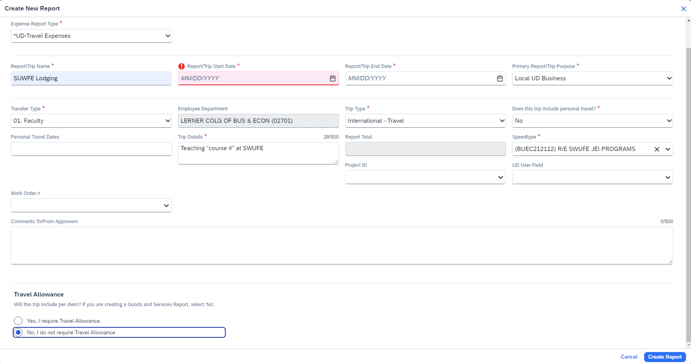
Check-in
Check-out

Slide 6
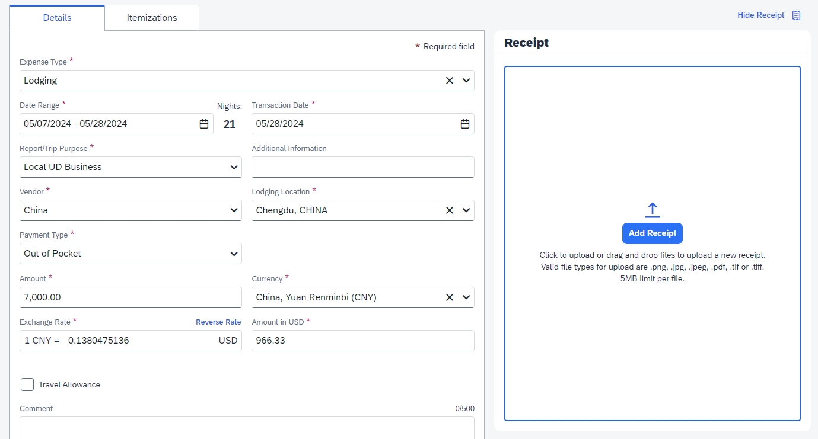
Upload the MOU

Slide 7
Per Diem Food Allowance
As a Lerner College faculty member, you are entitled to a food allowance during your stay at SWUFE, as follows:
Faculty (1,500 RMB per month)
You will receive an MOU from Dora before your trip to China, and you can submit it to Concur once you return from China.
Some helpful tips for submitting your per diem housing allowance in Concur follow.

Slide 8
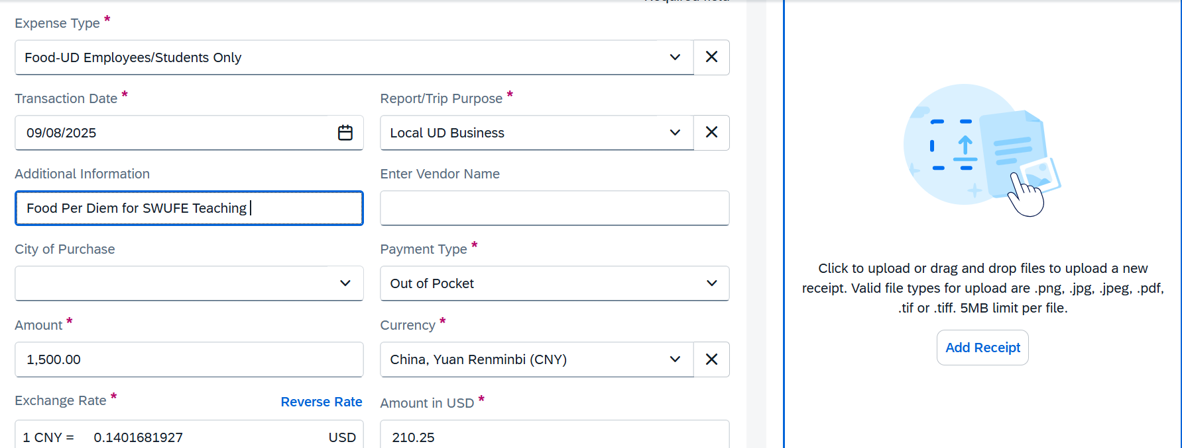
First day of teaching
The amount you should receive
Choose Yuan
Upload the MOU

Slide 9
Other Important Information

Slide 10
Before your trip
Set up Alipay and WeChat--please let Dora know if you need assistance
Set up VPN and 2FA code for travel--please let Dora know if you need assistance
Register International Health Insurance - GeoBlue and Crisis24—see instructions on the following slides.

Slide 11
GeoBlue
Register your account with GeoBlue
Member Registration | GeoBlue Students
Use the Group Code: GTB9999UDBKT
Once registered, travelers can access resources by clicking onto GeoBlue Resources
GeoBlue | International Student Health Insurance (geobluestudents.com)

Slide 12
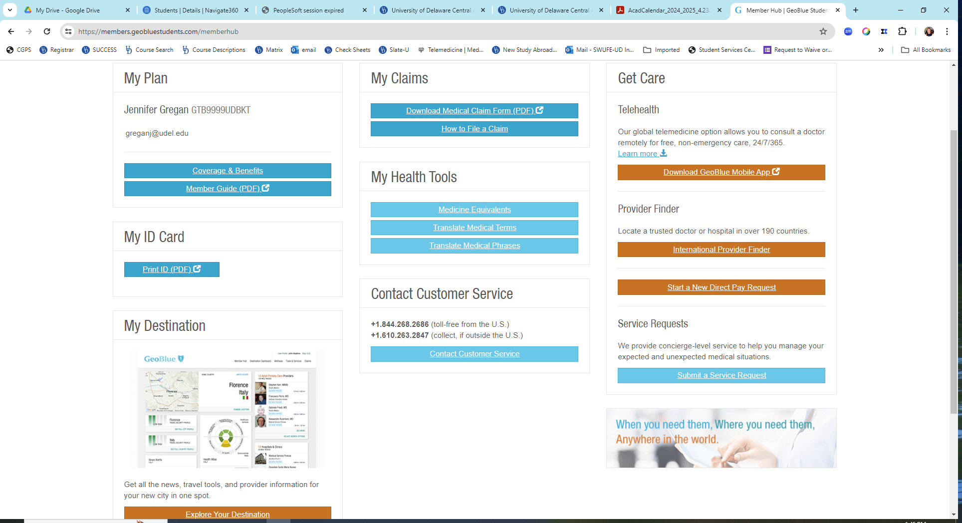



Slide 13
Crisis24
Register your account with Crisis24
https://www.drum-cussac.net/login

Slide 14
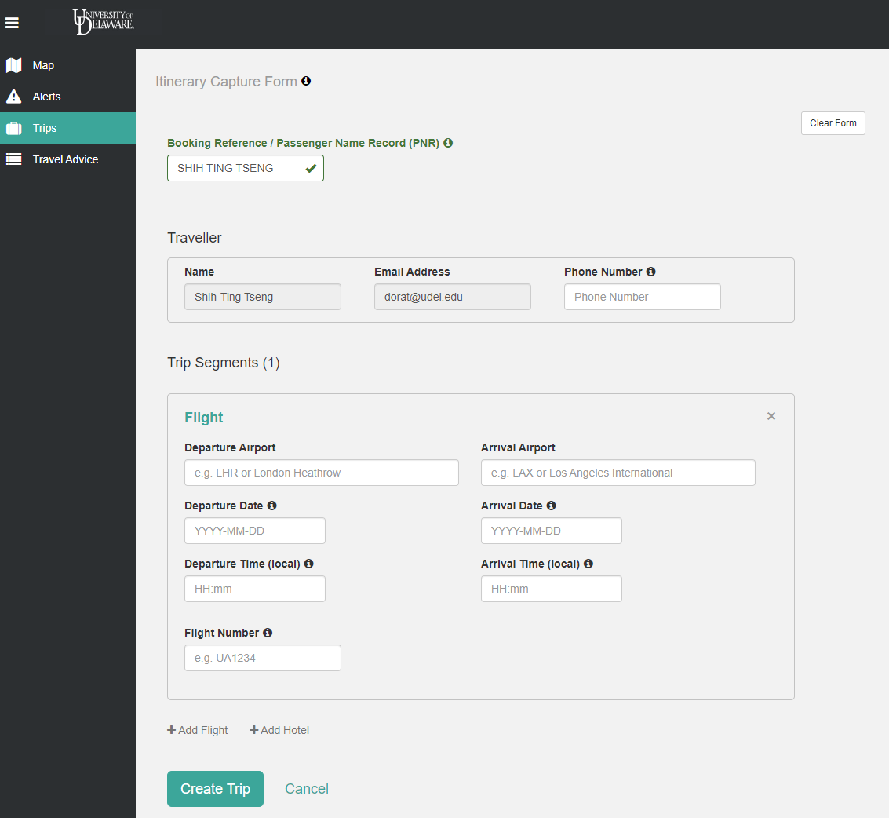



Steps:
Enter your UD email
Create your trip details

Slide 15
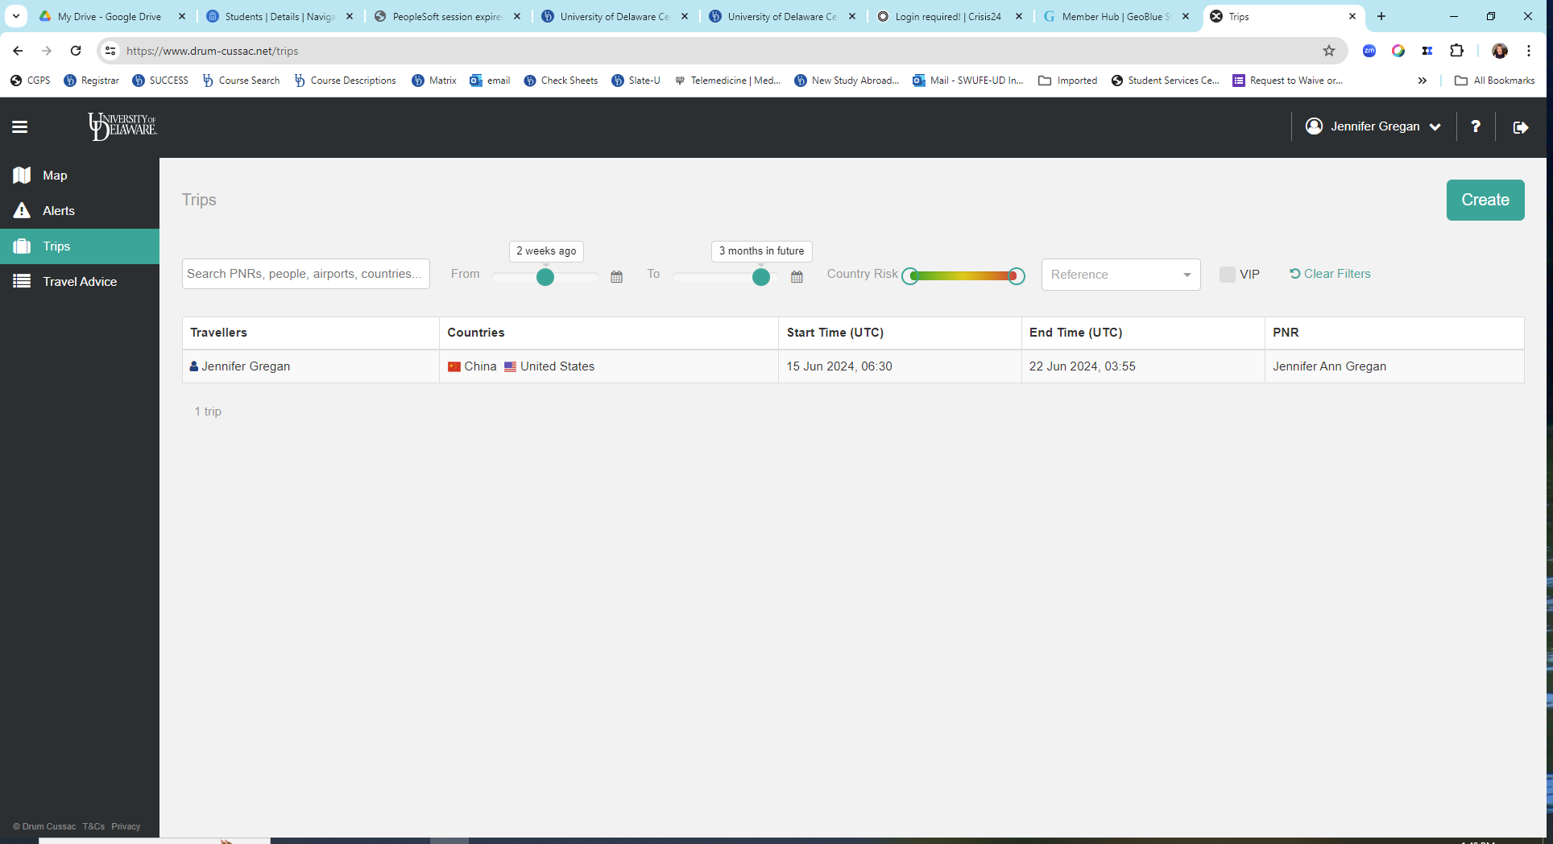



Slide 16
Airport Shuttle (USA)
UD will reimburse your shuttle between the US airport and your home. You can take a taxi, Uber, train, or the transportation that works best for you. Each way can be reimbursed up to $600.
Airport Shuttle Recommendation
Shared Ride (supertranspa.com)
Airport Shuttle from Philadelphia to JFK and Newark International Airports (acescorpshuttle.com)

Slide 17
Airport Shuttle (China)
SWUFE provides airport pick-up services in China; please email your arrival information to Leo (lizeyu@swufe.edu.cn) once your flight tickets are booked.

